Slide 1


Slide 2
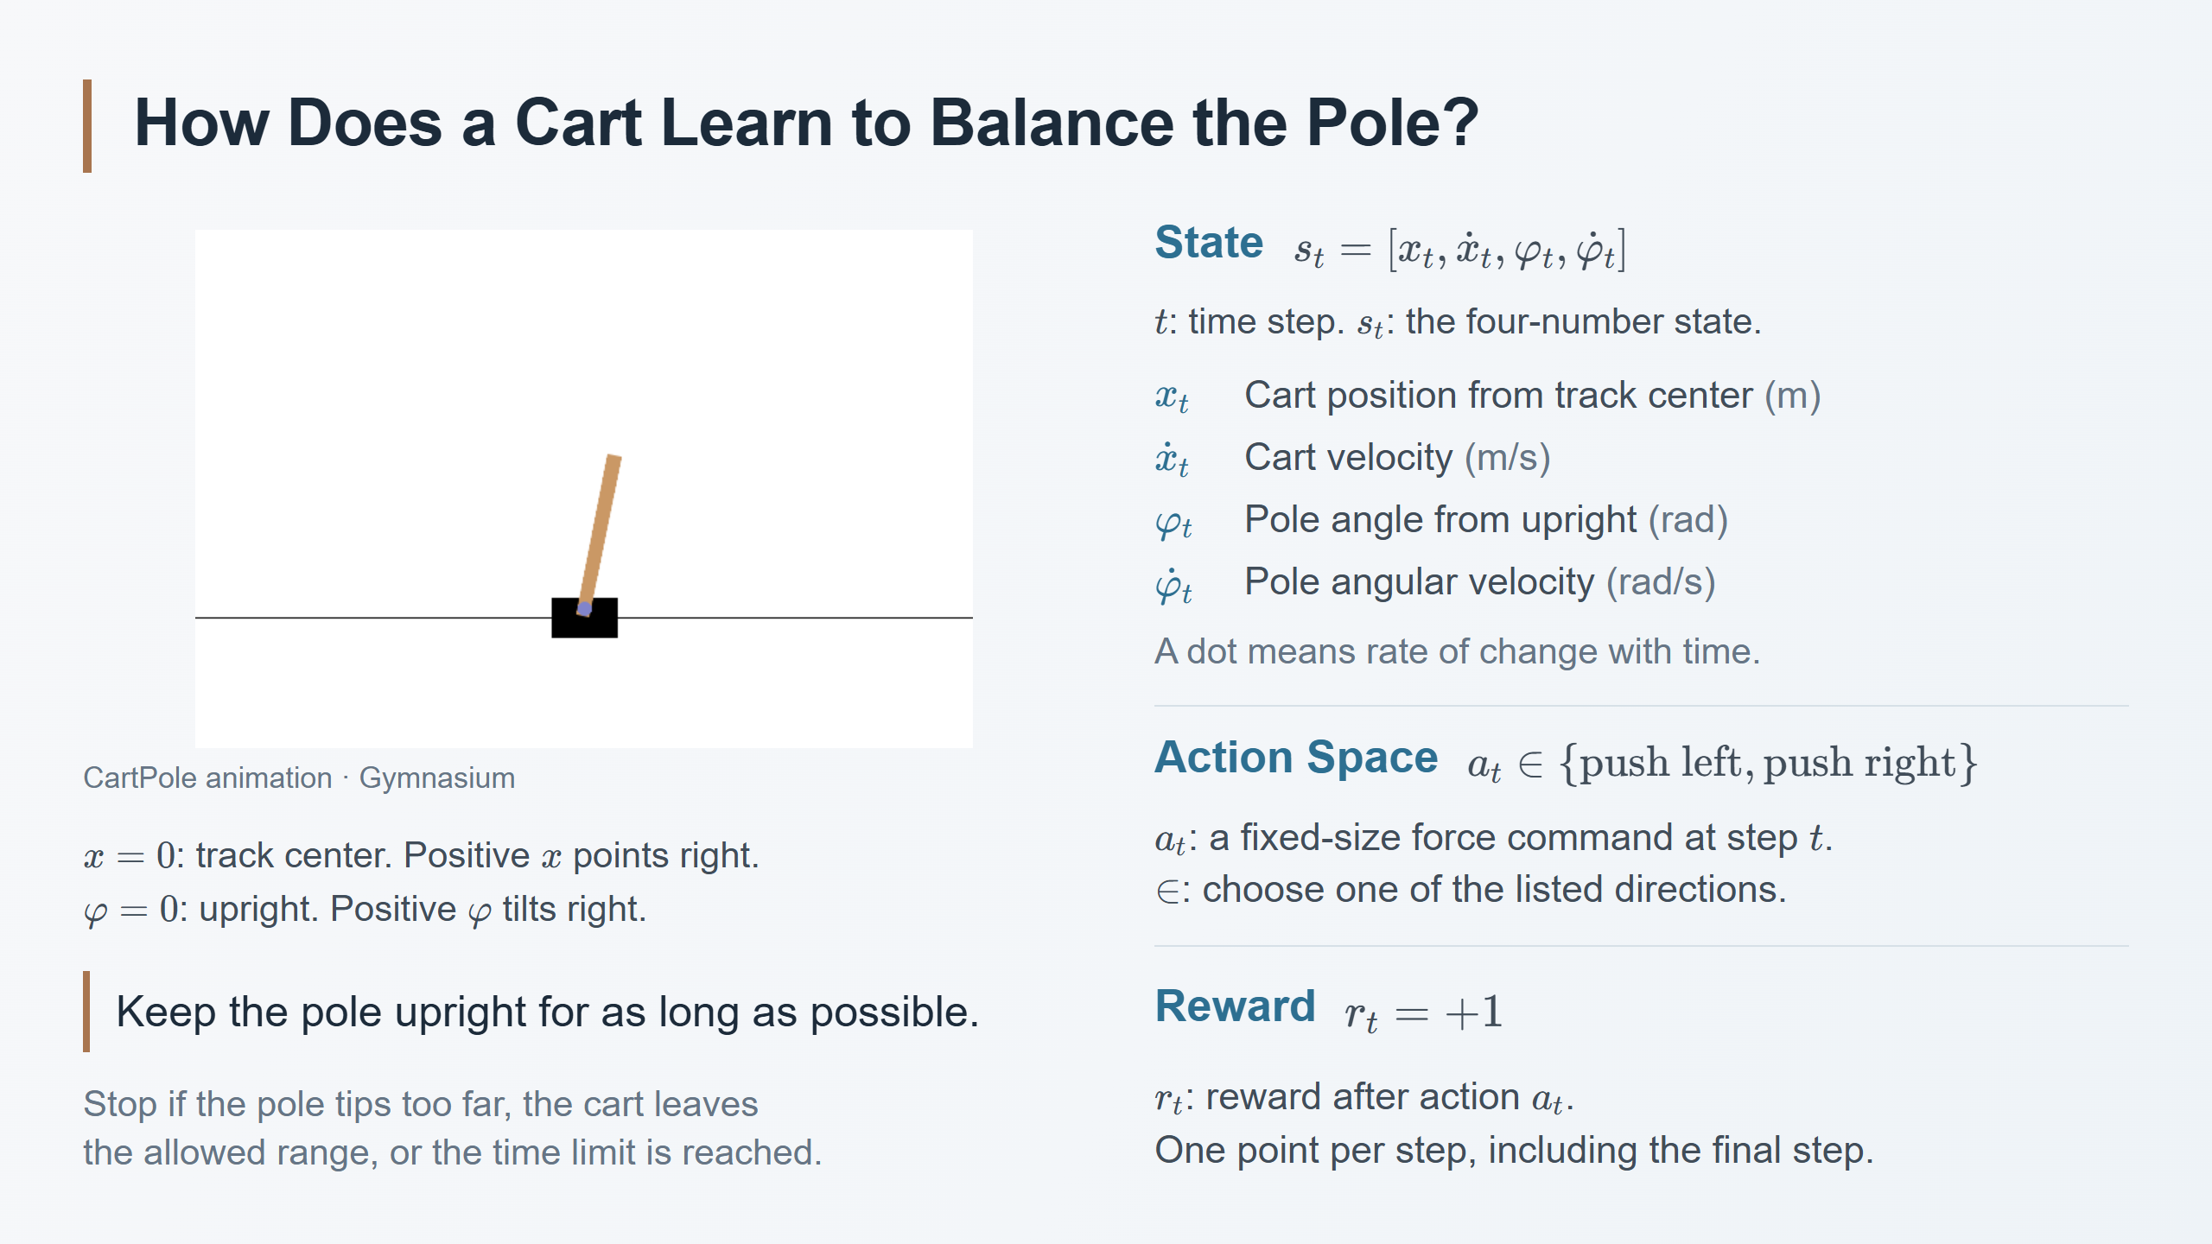
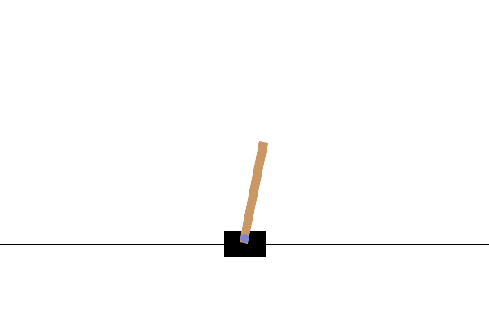
Notes:
Speaker notes
The goal is to move the cart so the pole stays upright. The agent applies a fixed-magnitude horizontal force to the cart, not a position command and not torque directly on the pole. The animation is the official Gymnasium task illustration; it is not an experiment from either REINFORCE paper.
Read the state vector in order. The square brackets list four values measured at the same discrete step t. x_t is cart position relative to the track center. x-dot_t is horizontal velocity. phi_t is pole angle relative to vertical. phi-dot_t is angular velocity. The subscript t is the time-step index, not physical elapsed seconds. A dot denotes a derivative with respect to physical time. Units: m means metres, s means seconds, and rad means radians. Position is positive to the right and pole angle is positive toward the right of upright in this convention.
Explain why velocity is needed: two poles at the same angle can be moving in opposite directions. One is falling farther over, the other is recovering. Those states need not call for the same action.
a_t is the action at step t. The braces list the allowed alternatives and the membership sign means one of those alternatives is selected. Both commands apply the same force magnitude in opposite directions. The policy will later assign probabilities to those commands, but policy notation is deliberately introduced on the next slide.
r_t is the reward returned after applying a_t and observing the resulting transition. This slide uses Gymnasium CartPole-v1's default +1 reward for every transition, including the terminal transition. It does not add a negative failure reward. An 80-step episode therefore earns 80 points.
An episode starts from reset and ends when pole tilt exceeds roughly 12 degrees, cart position leaves the ±2.4 m range, or the standard 500-step time limit is reached. The latter is a time-limit truncation rather than physical failure. Explain limits orally, without adding more symbols to this setup slide.
References: https://gymnasium.farama.org/environments/classic_control/cart_pole/
Animation: https://gymnasium.farama.org/_images/cart_pole.gif
This setup is the common example for the subsequent Williams (1992) and Sutton et al. (1999) discussion. No algorithm is being attributed to the animation.

Slide 3
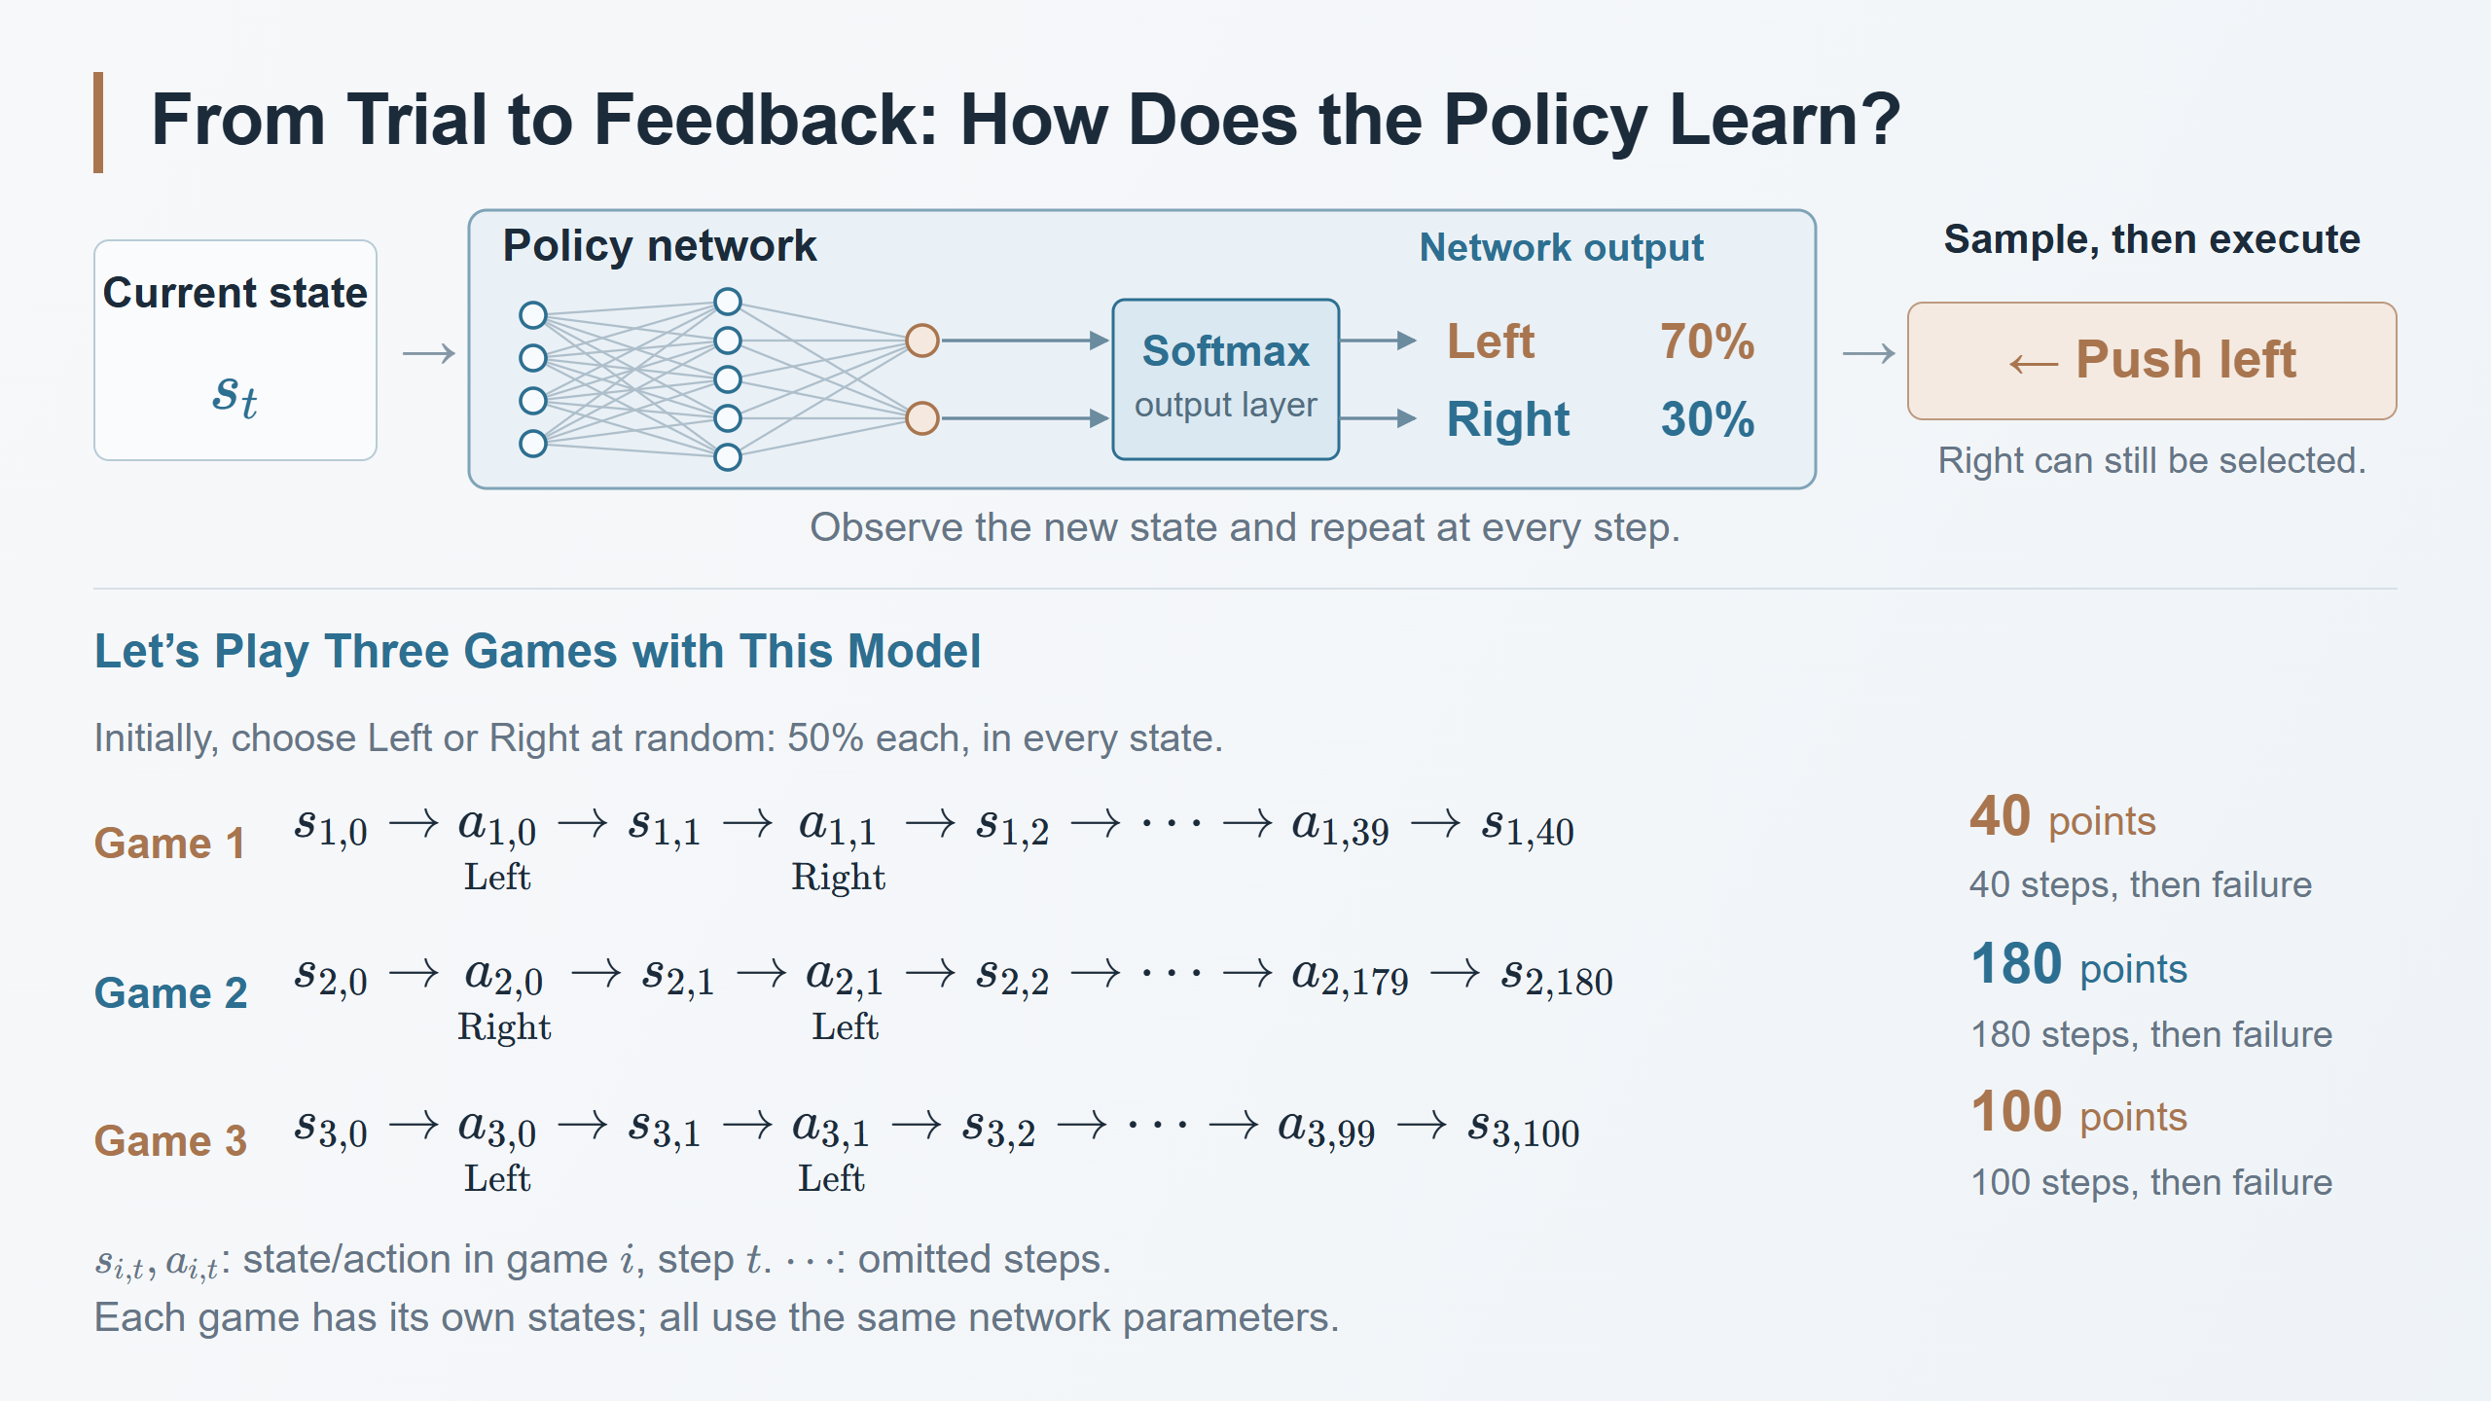
Notes:
Speaker notes
Teaching sequence: begin with one decision at the top, repeat it to form a trajectory, then compare the total rewards at the ends of the three trajectories. Introduce the symbolic probability distribution and its learning rule on a later slide, after students understand this interaction sequence.
The upper diagram illustrates action selection at one state: the network outputs Left 70% and Right 30%, and sampling selects one possible left push. For the three games below, separately choose a uniform initial policy: Left 50% and Right 50% for every state. Each game action is sampled from these equal probabilities. A concrete implementation is to initialize the final linear layer with zero weights and equal biases while retaining random hidden-layer weights, so the two action scores start equal for every input. A generic random initialization does not guarantee exactly 50/50; this is our chosen initial policy. The percentages describe action-selection probabilities, not task-success probabilities. The four inputs represent the four state measurements from the preceding slide. The hidden layer size is schematic. Softmax jointly normalizes the two action scores into probabilities summing to one.
Read the first row aloud: start in state s_{1,0}, choose action a_{1,0} (a left push), observe s_{1,1}, choose a_{1,1} (a right push), observe s_{1,2}, and continue until the trial ends. The second row begins with a right push, while the third starts with Left again and has a different later history, illustrating how sampling can produce another sequence from its own starting state, using the same fixed network. Before training, every new state still produces equal 50/50 probabilities. Keep the network parameters fixed throughout all three games. Sample a new action at each step, collect the three trajectories, and use their rewards to motivate the first update on the next page. After learning begins, the probabilities can depend on the state.
s_{i,t} is the state and a_{i,t} the action in game i at step t, starting from zero. Each game has its own initial state s_{i,0} and subsequent states. No equality between the initial states is assumed. The ellipsis omits intermediate steps. The same neural-network parameters process each recorded state separately; this does not make its action probabilities state independent. Equal 50/50 probabilities at every state are solely the chosen uniform initialization.
Forty actions are indexed from a_0 through a_39 and finish in s_40. One hundred eighty actions are indexed from a_0 through a_179 and finish in s_180. The default CartPole reward is +1 for every executed action/transition, including the terminal transition, so these invented teaching examples total 40, 180, and 100 points. The third game starts with two left pushes and has 100 actions, indexed a_0 through a_99, ending in s_100. All three games use their own initial states and the same unchanged uniform policy. The trajectories, first two actions and durations are illustrative, not measured experimental results, typical performance claims for a random policy, or before/after training comparisons.
Conclude with the learning question: how should the rewards from these interactions change the network's future action choices? A better total does not prove that every action in the longer trajectory was good or that every action in the shorter trajectory was bad. The next slide can introduce how REINFORCE uses reward following sampled actions to change their selection probabilities.
Task and reward reference: https://gymnasium.farama.org/environments/classic_control/cart_pole/
Background for the subsequent algorithm discussion: Ronald J. Williams (1992), Simple Statistical Gradient-Following Algorithms for Connectionist Reinforcement Learning, https://doi.org/10.1007/BF00992696
The network and trajectory diagrams are original teaching schematics, not figures from a paper.

Slide 4
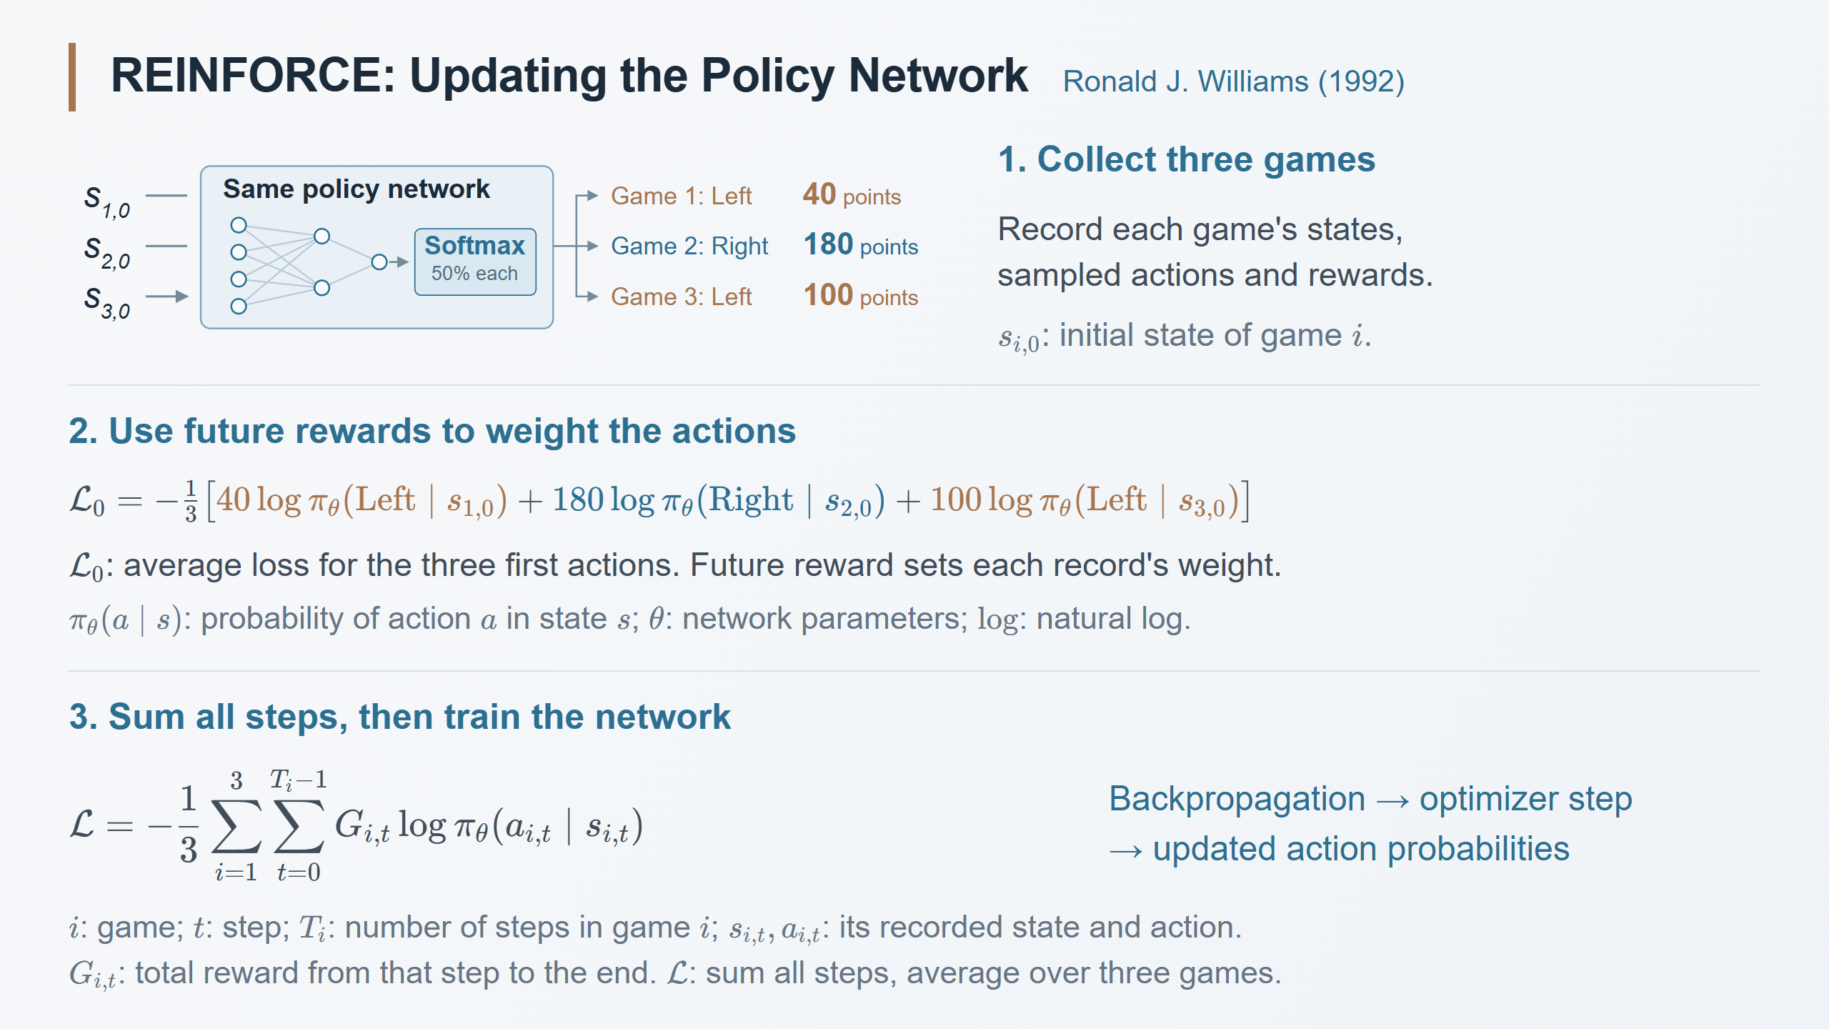
Notes:
Speaker notes
Explain only three steps: collect experience, use future rewards to construct a loss, and train the network with ordinary backpropagation and an optimizer. Do not derive hidden-layer gradients, introduce hidden features h, or give arbitrary numerical gradients. The preceding slide contains the full three example trajectories; this page reuses their first actions and outcomes before extending the loss to all their steps.
Each game has its own initial state and subsequent states. All games use the same network, held fixed while collecting the batch. The chosen uniform initialization produces Left 50% and Right 50% at each state; the earlier 70/30 action-selection diagram is a separate illustration. Game 1 first chooses Left and later collects 40 points, Game 2 Right and 180 points, Game 3 Left and 100 points. These are invented teaching outcomes, not measured performance or immediate first-step rewards. Each log probability is evaluated at its own recorded state. Do not combine the two Left terms into a single probability, or assume one updated probability pair applies to all states.
For one record the loss is minus future cumulative reward times the natural logarithm of the sampled action's probability. No expert target action is supplied. Treat the recorded reward as a fixed training weight: increasing a positive return increases the weight of that record's contribution. This does not guarantee every sampled action's probability rises after the combined update, because different samples share network parameters. L_0 isolates the first action of each game and averages the three contributions. It is only an introductory example, not an extra optimizer step before the full loss.
The full loss L sums contributions from every step of each game, then averages the three game sums. i is the game index, t the step index, T_i the number of actions, s_{i,t} the recorded state, a_{i,t} the sampled action, and G_{i,t} the sum of rewards from that step through the end. With +1 per step, the return weights are 40,39,...,1; 180,179,...,1; and 100,99,...,1. The summation signs add those terms; do not normalize each game by its length. This introduction uses no discount or baseline. Feed this full scalar loss to the usual backpropagation and optimizer, which update the network parameters automatically. Then collect fresh games using the updated policy. The key algorithmic idea here is constructing a learning signal from rewards, not a new way to differentiate a neural network.
Source: Ronald J. Williams (1992), Simple Statistical Gradient-Following Algorithms for Connectionist Reinforcement Learning, https://doi.org/10.1007/BF00992696 . Modern episodic implementation: https://spinningup.openai.com/en/latest/spinningup/rl_intro3.html . The example and diagram are original teaching material.

Slide 5
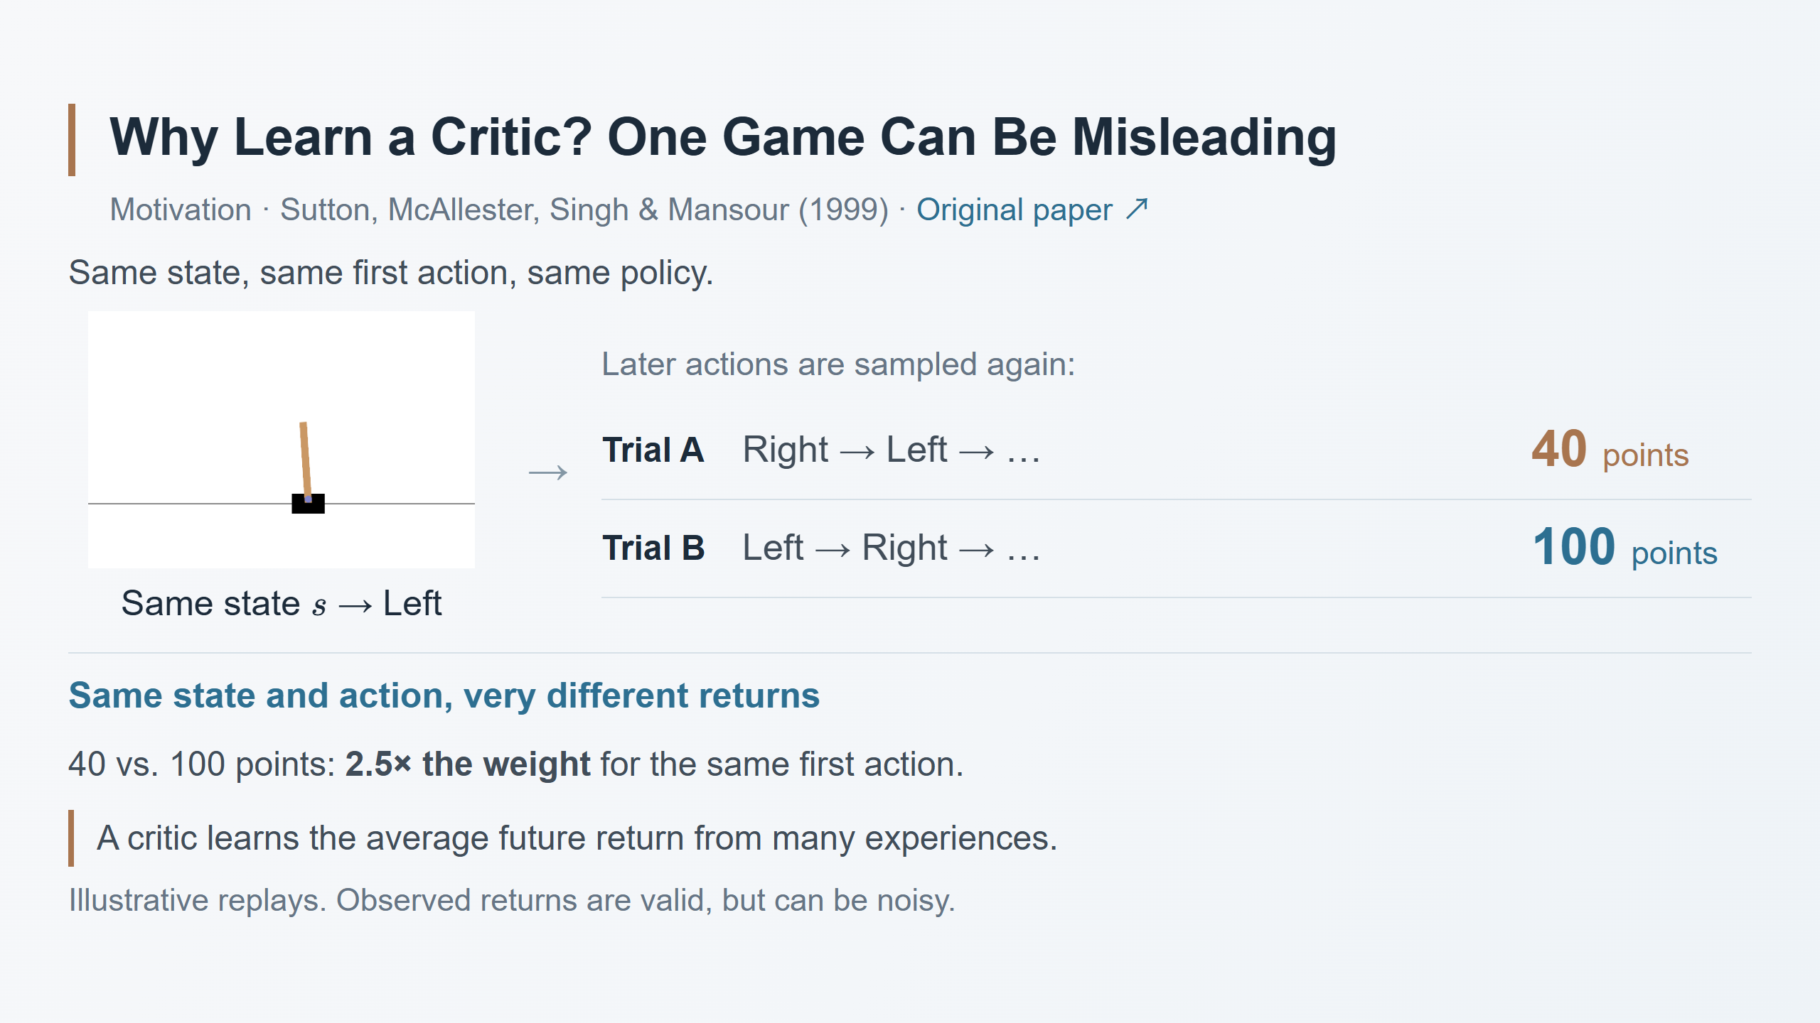
Notes:
Speaker notes
This is a NEW illustrative replay experiment, not a reinterpretation of the three previous games. Use Trial A and Trial B rather than Game 1 and Game 2. In the earlier three games the initial states can differ and first actions are Left, Right, Left. Here we deliberately reset to exactly the same complete CartPole state s, take Left as the first action in BOTH replays, and keep the policy parameters fixed. Subsequent actions are sampled independently, so later states and durations can differ. The generic Gymnasium animation is context, not a recorded replay of either numerical trajectory. The action snippets and 40/100 returns are invented teaching values, not simulated or measured results. s is the previously defined four-number cart-and-pole state; the ellipsis omits later actions.
With +1 per transition, cumulative first-action returns of 40 and 100 are also the respective episode lengths. The immediate reward is still +1 in both cases. Explain the difficulty of using one observed cumulative return as a weight; do not confuse this with using only immediate reward, which would ignore the future. REINFORCE's first-action contributions have the same input, sampled action, network parameters and log-probability derivative in these two replays. Only their observed return weights differ. The second record consequently carries 100/40=2.5 times the first record's first-action weight. Do not claim that their FULL trajectory gradients differ by exactly 2.5, since later actions and states differ. Both weights are positive; these two records do not by themselves give opposite update directions or prove the first action good or bad.
The point is variance: later random choices can change the observed outcome even when the first state-action pair is identical. Raw returns remain valid Monte Carlo samples of the action value under the policy and, with the proper on-policy estimator, give valid policy gradients. This is not a counterexample to REINFORCE's correctness. Averaging more rollouts can already reduce sampling noise, without a critic. A fitted critic offers a way to combine and generalize experience across states and actions into an estimate of the conditional expected return. It is not a source of ground truth and may introduce approximation error; do not assert that any learned critic necessarily has lower error or an unbiased policy gradient.
Transition to the next slide: we want an evaluator answering what usually happens after this state and action, under the current continuation policy. The next two slides introduce Actor–Critic roles, then combine critic fitting and actor updates. The paper's compatibility and fitting conditions are retained in the speaker notes. Do not introduce hidden features or network-internal derivative calculations here. Fitting with complete returns still requires completed episodes; early updates through TD bootstrapping are a later topic.
Source for motivation: Sutton, McAllester, Singh & Mansour (1999), Policy Gradient Methods for Reinforcement Learning with Function Approximation, introductory discussion on PDF page 2 of learning a value function to reduce variance in gradient estimation: https://papers.nips.cc/paper_files/paper/1999/file/464d828b85b0bed98e80ade0a5c43b0f-Paper.pdf#page=2 . The numerical example and diagram are original teaching material. Task animation: https://gymnasium.farama.org/environments/classic_control/cart_pole/ . The visual is intentionally reused as part of the same CartPole example.

Slide 6
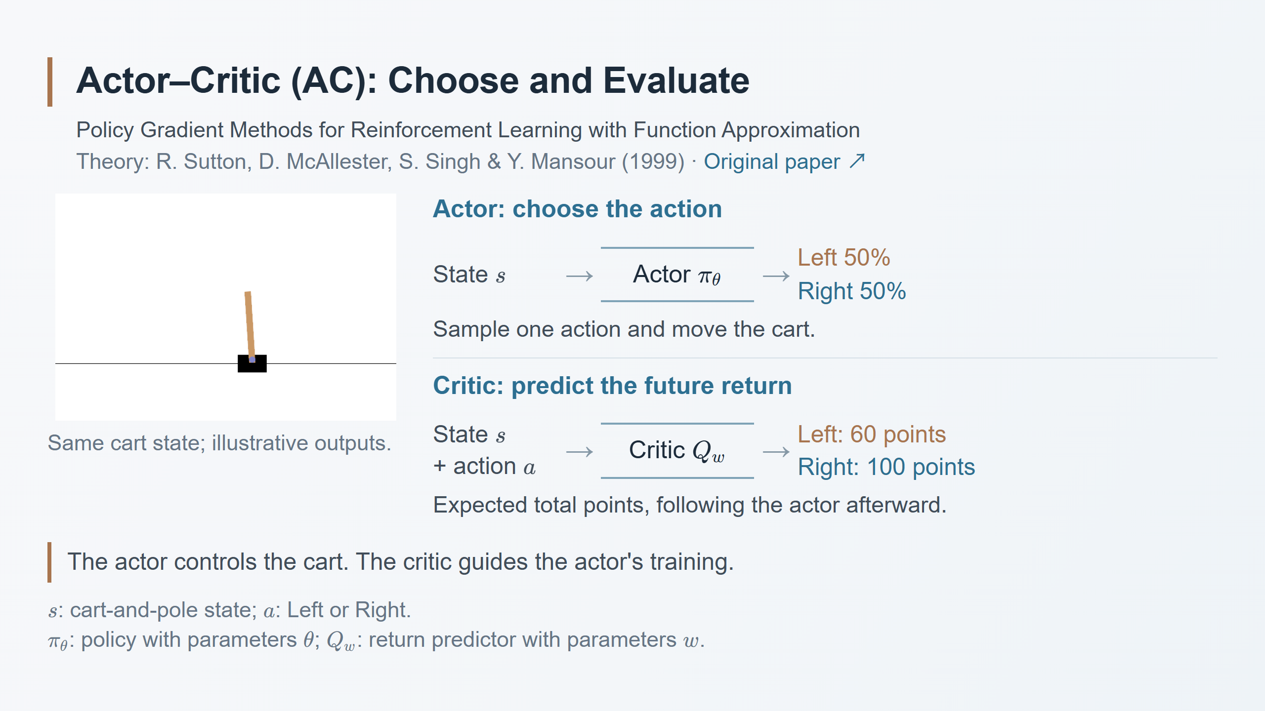
Notes:
Speaker notes
These two slides introduce Actor–Critic (AC), using a learned action-value critic. AC is a family of methods; the 1999 paper supplies theoretical foundations and did not invent the framework. This is an introductory Monte Carlo critic example, not A2C or A3C, and the paper did not report this CartPole experiment.
Use the same CartPole task. State s contains cart position, cart velocity, pole angle and pole angular velocity. Action a is a left or right push. The actor pi_theta receives the state and produces an action distribution. theta means its trainable parameters. With the illustrative 50/50 distribution, sample an action and execute it. The actor, rather than a greedy choice made by the critic, controls the cart.
The critic Q_w receives a state and candidate action and predicts the expected remaining cumulative reward: take that action now, then follow the current actor. w denotes the critic's trainable parameters. With +1 per transition, Left 60 points and Right 100 points are estimates of total future rewarded steps, including the transition from the selected action. They are not immediate rewards, probabilities, measured outcomes or guarantees. The predictions refer to the same illustrative state and need not match any initial state in the three earlier games. A critic can be fitted while the actor remains at 50/50. Higher expected return gives a learning signal for the actor, not a mandatory immediate switch to a deterministic action.
The next slide explains how experience trains both networks. No hidden-layer gradient calculation is needed. The generic animation is context, not a replay of a numerical experiment.
Sources: Richard S. Sutton, David A. McAllester, Satinder P. Singh and Yishay Mansour (1999), Policy Gradient Methods for Reinforcement Learning with Function Approximation, Sections 1–3: https://papers.nips.cc/paper_files/paper/1999/file/464d828b85b0bed98e80ade0a5c43b0f-Paper.pdf . CartPole animation: https://gymnasium.farama.org/environments/classic_control/cart_pole/ . The task image is intentionally reused to continue the user's example; all numerical values and diagrams are teaching illustrations.

Slide 7
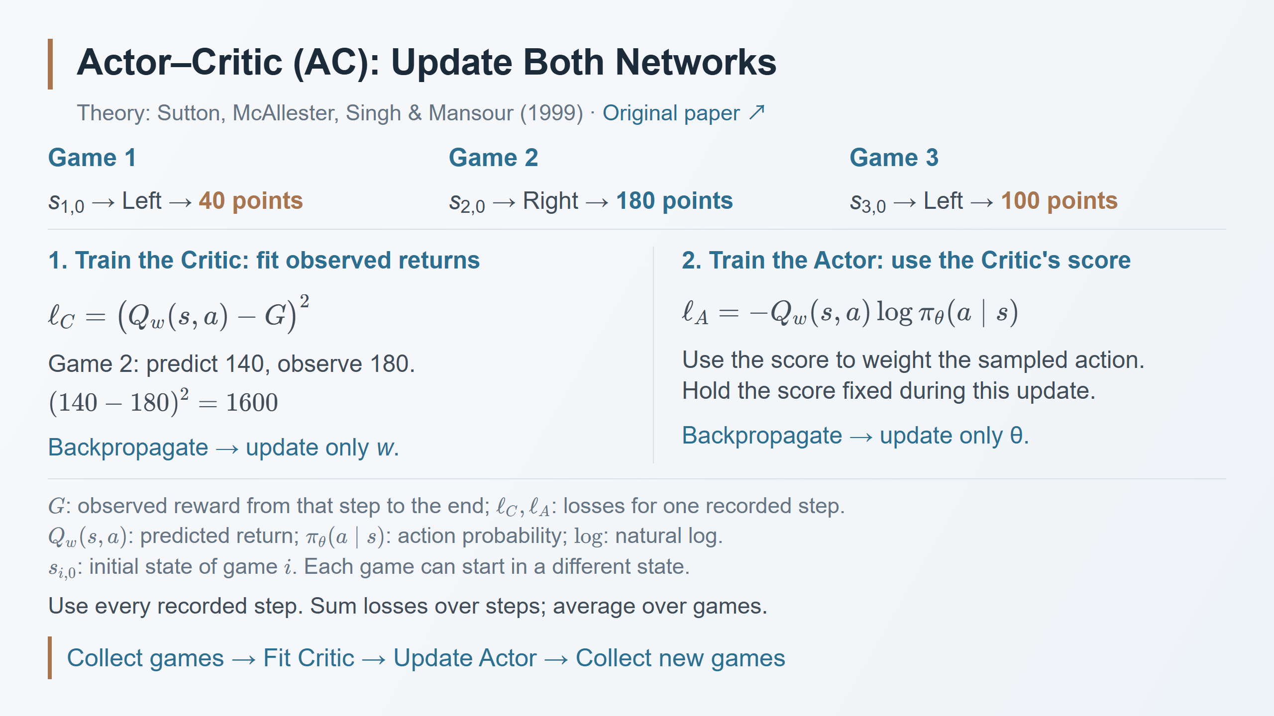
Notes:
Speaker notes
Use the original three trajectories: Game 1 begins with Left at s_{1,0} and returns 40; Game 2 begins with Right at s_{2,0} and returns 180; Game 3 begins with Left at s_{3,0} and returns 100. Their states need not match. The arrows summarize the first state, first sampled action and subsequent episode return, not an immediate action reward. These are not the separate same-state 40/100 replays on the motivation slide. Keep the actor fixed while collecting these games. i indexes games and 0 is the first step. All displayed numbers are illustrative.
First update the critic. Each recorded state-action pair has an observed remaining return G. With +1 per step, Game 1 supplies targets 40,39,...,1; Game 2 supplies 180,179,...,1; Game 3 supplies 100,99,...,1. Fit Q_w to these targets by squared-error regression. For the Game 2 first action, an illustrative current prediction of 140 and observed return of 180 give (140-180)^2=1600. Backpropagate the accumulated critic loss and let an optimizer change w, leaving theta fixed. One optimizer step need not move the prediction exactly to 180. Many observations train a conditional mean; a single observed return is not the true expected value. The scores 60/100 on the preceding slide were for a separate illustrative state.
Then update the actor. For each recorded state-action pair, obtain the critic's current predicted return and use it as the weight of minus log pi_theta(a|s), replacing the raw G used by REINFORCE. ell_A and ell_C denote individual step losses, not the complete batch objectives. Sum over steps and average the trajectory sums over the three games, consistent with the previous REINFORCE slide. Use each step's own state and action. Do not collapse different states into one probability pair. pi_theta(a|s) is the probability of the recorded sampled action conditional on its recorded state; log is the natural logarithm.
Hold Q_w(s,a) fixed as a numerical weight during the actor update: detach its value from this loss's gradient. Backpropagate through the actor and let an optimizer update theta only. The critic's weights w are trained by their own regression objective. Both networks here have separate parameters. The optimizer uses ordinary gradient descent; no hidden-state features or internal derivative arithmetic are required. Combining gradients through shared actor parameters does not ensure every sampled action's probability rises. The actor still samples actions, rather than being replaced with a greedy critic.
After the actor changes, collect new games and repeat, because its future returns and the critic's prediction target also change. This example uses completed Monte Carlo returns to train a Q critic. It does not yet use a V baseline, advantage, TD bootstrapping, A2C or A3C; do not claim the critic removes the need to finish games in this particular illustration. This is one introductory actor-critic construction rather than a definition requiring all AC algorithms to use the same loss or training schedule.
The 1999 paper is the theoretical reference. Section 2 permits fitting an action-value approximator with unbiased return targets, possibly observed returns, and Theorem 2 shows agreement with the true policy gradient only under both weighted fitting/stationarity and compatible-function-approximation conditions. An arbitrary neural critic trained on these examples need not satisfy those conditions and may bias the actor's gradient. Section 3 discusses compatible advantage functions and state-only baselines. These theoretical qualifications are retained in notes rather than a third slide; the displayed Q critic and CartPole numbers are a teaching schematic, not a reproduction of the theorem's full construction or a guarantee of convergence.
Source: Sutton, McAllester, Singh & Mansour (1999), Policy Gradient Methods for Reinforcement Learning with Function Approximation, especially Section 2 / Theorem 2 / Eqs. (3)–(5): https://papers.nips.cc/paper_files/paper/1999/file/464d828b85b0bed98e80ade0a5c43b0f-Paper.pdf .

Slide 8
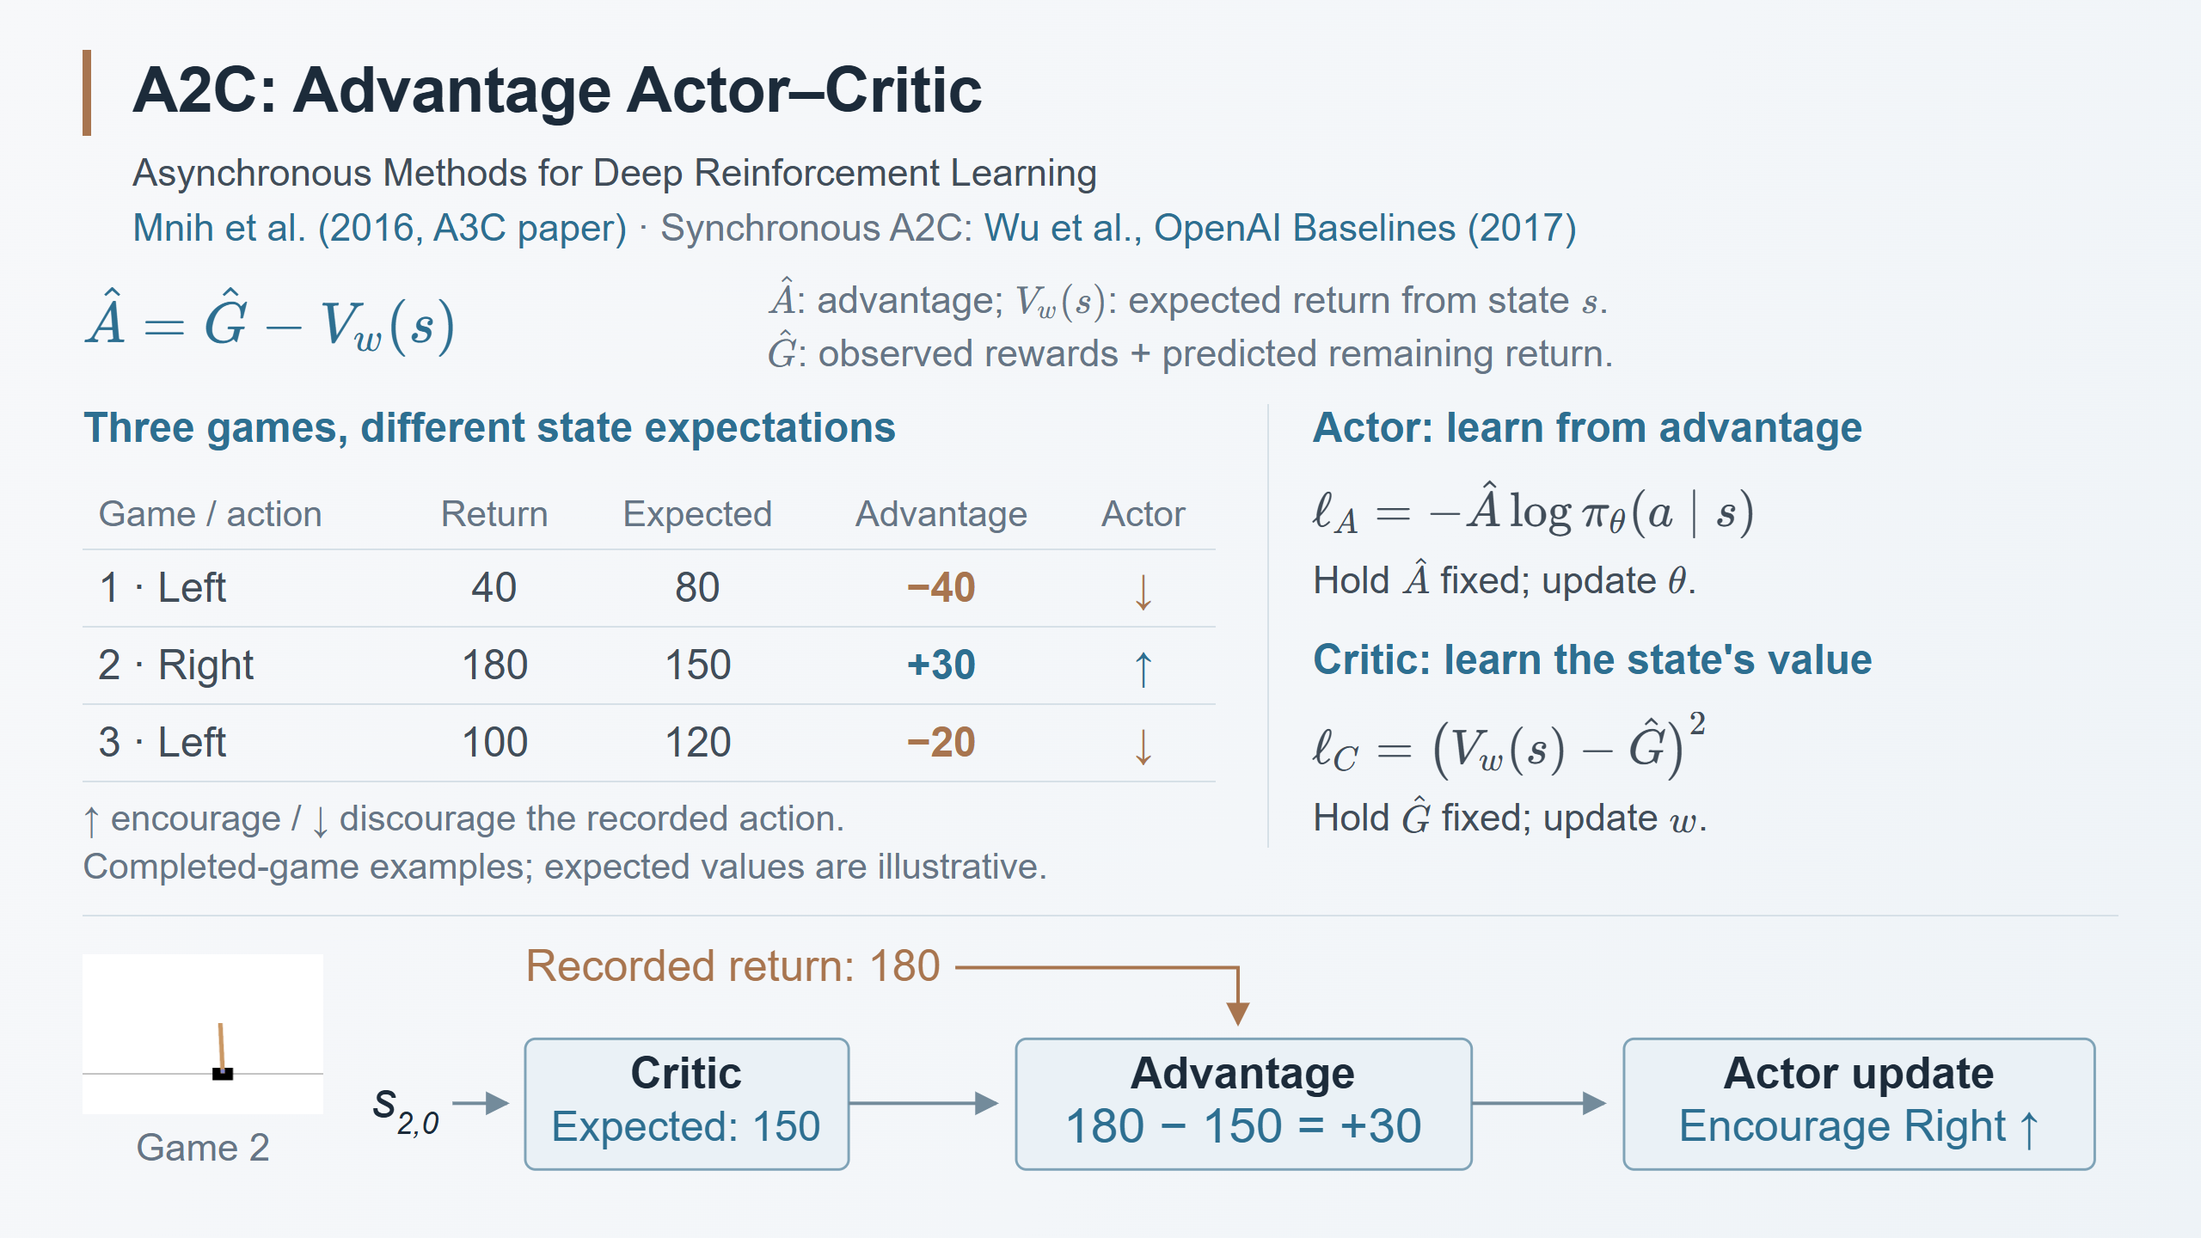
Notes:
Speaker notes
This slide introduces synchronous Advantage Actor–Critic, A2C. The 2016 paper by Volodymyr Mnih, Adria Puigdomenech Badia, Mehdi Mirza, Alex Graves, Tim Harley, Timothy P. Lillicrap, David Silver and Koray Kavukcuoglu introduced A3C, not a separately titled A2C algorithm. The 2017 OpenAI Baselines release by Yuhuai Wu, Elman Mansimov, Shun Liao, Alec Radford and John Schulman describes the synchronous version called A2C. The top source line distinguishes these. A2C is within the actor-critic family; advantage baselines, bootstrapping and parallel collection are not exclusive inventions of A2C.
The preceding example used a Q critic trained from complete returns. Here the critic predicts V_w(s), the expected future return from the state under the current policy, before selecting an action. It does not take that candidate action as input. This is the key change from Q_w(s,a). s and a retain their earlier meanings; theta and w are actor and critic parameters; pi_theta(a|s) is the sampled action's probability; log is the natural log. ell_A and ell_C are per-record losses. A hat denotes an estimate: A_hat is the estimated advantage and G_hat is a return target.
Continue the three original games and their separate initial states: Game 1 first chooses Left and returns 40; Game 2 first chooses Right and returns 180; Game 3 first chooses Left and returns 100. For this example only, suppose the state-value critic predicts 80, 150 and 120 at those three respective initial states. These are hypothetical V estimates, not the earlier Q predictions and not numbers measured in an experiment. The advantages are 40-80=-40, 180-150=+30 and 100-120=-20. Thus a positive score of 100 may still be below what was expected from that state. The arrows show the direction encouraged by each individual sample's actor-loss contribution, not a guarantee about all probabilities after a combined shared-network update. The examples have complete returns and use no discount; all steps would be used during training, not just these first actions. The bottom diagram isolates Game 2: its recorded Right action yields return 180, the rollout-time state-value estimate is 150, and their difference +30 weights the actor update. The generic CartPole animation identifies the task; it is not a recording of that illustrative game. The diagram shows a training-data flow, not a runtime controller. The Actor update box expresses this record's learning signal, not a guaranteed batch-level change or a numeric new action probability. The critic's own regression loss remains above. The editable diagram follows the existing lecture's vector style.
For ordinary short A2C rollouts, the return target combines recorded rewards with a state-value prediction at the segment's end. More precisely, G_hat_t = sum_{j=0}^{k-1} gamma^j r_{t+j} + gamma^k V_w(s_{t+k}); t is the current step, k the segment length, j the reward offset, r the reward for that transition and gamma the discount factor. The numeric slide example uses gamma=1. For a genuine terminal state the remaining value is zero. A time-limit truncation is not automatically a terminal state: bootstrap from its final observation when appropriate. This target avoids requiring every game to finish, but introduces dependence on prediction quality. No claim of an always superior estimator is intended.
Compute targets and advantages using rollout-time value estimates before applying the batch update. Keep those values fixed while optimizing the losses. The actor loss uses detached advantage; the critic loss uses a detached return target. The diagrams use separate theta and w for clarity; implementations can share features and combine the objectives. Entropy regularization, value-loss coefficients, gradient clipping and optional advantage normalization are omitted from this introductory page, not denied as implementation features. Do not train the critic to interpolate the current batch and then recompute zero residuals as the actor's advantages.
Explain the three benefits specifically relative to the immediately preceding completed-return Q-critic teaching example. First, the baseline gives signed feedback relative to a state's prospects and can reduce variance for a given policy-gradient estimator. It does not change the expected score-function gradient when it depends only on state and is held fixed. There is no general guarantee that A2C has lower variance or better performance than every Q-based actor-critic: target noise, approximation error and bootstrapping bias also matter. Second, bootstrapped short segments permit updates before episode completion. Third, multiple environments can use the same policy snapshot, collect segments, pool their experiences and update together; this supports efficient batching and mixes experience from different environment states. It does not make the policy deterministic, guarantee faster wall-clock time, or mean each cart learns a different policy. A3C's asynchronous workers are a separate later comparison.
Sources: Mnih et al. (2016), Asynchronous Methods for Deep Reinforcement Learning, Sections 3 and 4 / actor-critic formulation: https://arxiv.org/pdf/1602.01783 . Wu et al., OpenAI Baselines: ACKTR & A2C (2017), A2C and A3C section: https://openai.com/index/openai-baselines-acktr-a2c/ . Stable-Baselines3 A2C implementation: https://stable-baselines3.readthedocs.io/en/master/_modules/stable_baselines3/a2c/a2c.html ; parameters and CartPole vector-environment example: https://stable-baselines3.readthedocs.io/en/master/modules/a2c.html . All numerical CartPole examples are original teaching illustrations.

Slide 9
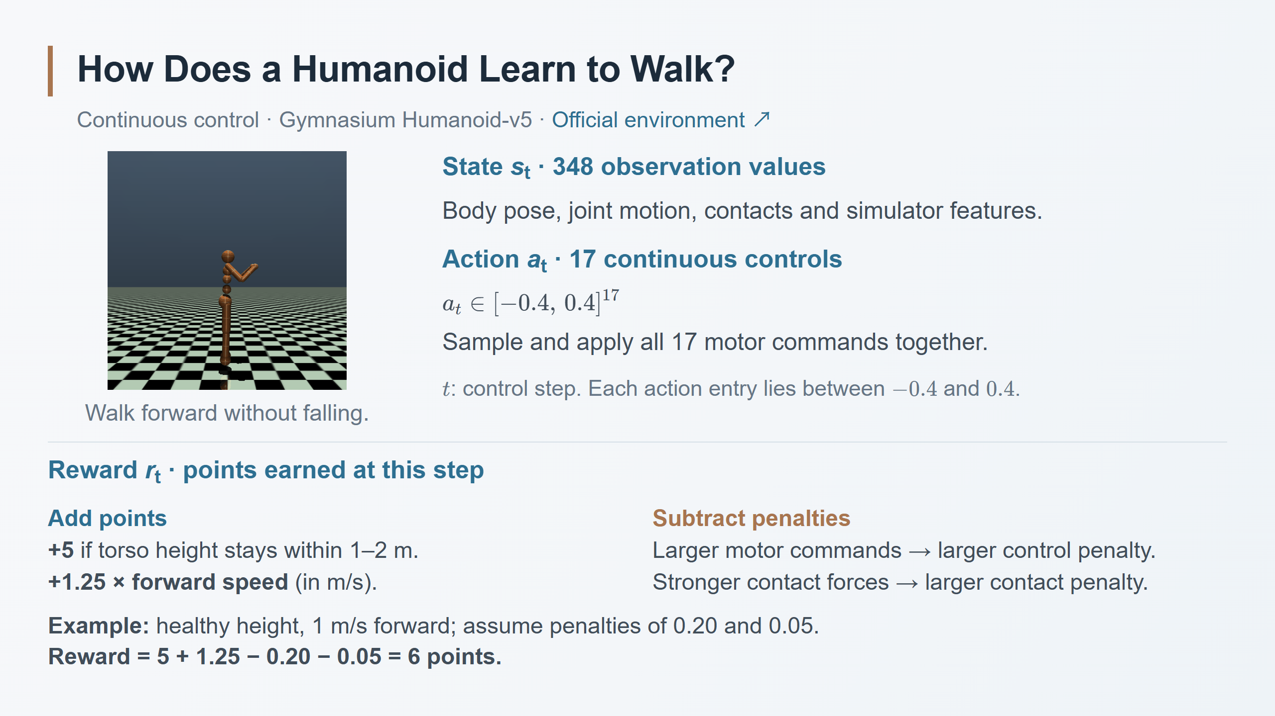
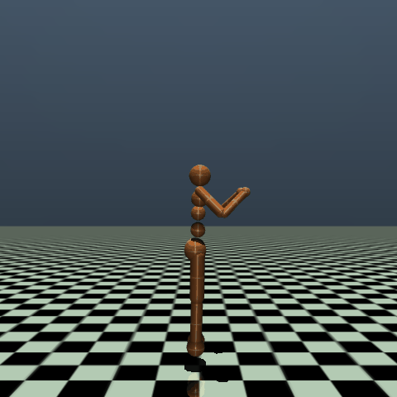



Notes:
Speaker notes
This slide introduces only the simulated humanoid walking task. The official Gymnasium GIF illustrates the body and task; it is not our experiment or evidence of a particular learning algorithm.
The default v5 observation has 348 entries and the action has 17 bounded control entries. s_t denotes the observation supplied to the policy at control step t; the lecture continues its earlier convenient state notation, without claiming arbitrary partial observations always equal the complete physical state. The observation contains positions and velocities plus simulator-provided body, actuator and contact features. The default omits global torso x/y position. These detailed simulated features need not all be directly measurable on a physical humanoid. The slide lists representative groups rather than a full 348-element schema.
a_t is one 17-dimensional continuous action vector applied together at a control step. The notation [-0.4,0.4]^17 means that every one of its 17 numerical entries is bounded in that interval. This model's motors control abdomen, hips, knees, shoulders and elbows. These are actuator control values; actual physical torques also depend on the MuJoCo actuator model and gains/gearing. Do not casually label all 17 numbers as directly calibrated Nm or assume every humanoid has 17 motors. A common stochastic actor predicts a multivariate Gaussian's parameters and samples an action, with appropriate handling of environment bounds. This is a change in output distribution from the CartPole Softmax, not an entirely new reinforcement-learning objective. Continuous pi(a|s) refers to a probability density.
r_t is the scalar reward returned after this control step, not the total score of the whole episode. The slide uses Humanoid-v5 defaults: +5 when the torso height is within the healthy range of 1 to 2 metres; a forward term equal to 1.25 times the centre-of-mass forward velocity in metres per second; minus control and contact penalties. Moving backward makes the forward term negative. The control penalty is 0.1 times the sum of squared action entries. The contact penalty uses a weighted sum of squared external contact-force entries, with the environment's clipping rule. The plain-language rows state the effect without adding new symbols. The example assumes healthy height, forward speed 1 m/s, a computed control penalty of 0.20 and a computed contact penalty of 0.05: 5 + 1.25 - 0.20 - 0.05 = 6.00. Those two example penalties are illustrative computed amounts, not fixed charges or measured rollout data. When torso height leaves the allowed range, the healthy bonus is lost and the episode ends by default; no extra fixed fall penalty is being invented. These rules specify the environment's reward, not a learned critic prediction.
Sources: Farama Foundation, Gymnasium Humanoid-v5 documentation, Action Space, Observation Space and Rewards sections: https://gymnasium.farama.org/environments/mujoco/humanoid/ . Official animation: https://gymnasium.farama.org/_images/humanoid.gif .

Slide 10
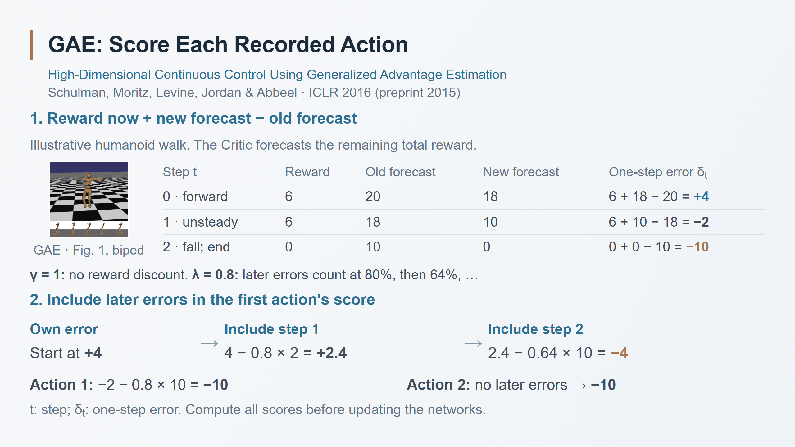
Notes:
Speaker notes
Read the completed segment in order. The old Actor and Critic were fixed while collecting it. At step 0, the old forecast includes this step and all remaining rewards: 20. The observed reward is 6; the same Critic forecasts 18 remaining after the transition. These do not double-count the 6. The revised estimate 24 is 4 above the prior forecast. At step 1, the revised estimate 6+10=16 is 2 below 18. At step 2, reward 0 and true-terminal future value 0 are 10 below the previous forecast. The -10 is a prediction error, not an invented fall penalty.
For this finite illustrative episode use gamma=1, so the later-error factor gamma*lambda is .8. For action 0, start with delta_0=+4; add .8*delta_1=-1.6, obtaining +2.4; add .64*delta_2=-6.4, obtaining -4. These are arithmetic stages, not three optimizer updates. Action 1 uses its own error and the final one: -2+.8(-10)=-10. Action 2 has only its own error: -10. Every action is the full 17-control vector at its own observation. Compute all advantages before changing either network.
The same values can be computed backwards by A_2=-10, A_1=-2+.8*A_2=-10, A_0=4+.8*A_1=-4. GAE estimates advantage; it does not establish that the first action uniquely caused the fall. gamma and lambda are configurable, not required to equal these illustration values. Lower lambda relies more on the critic; higher lambda includes more later sampling noise. GAE is an estimator that can also be used with A2C.
Sources: GAE Section 3, Eqs. (10), (16)–(18), https://arxiv.org/pdf/1506.02438 . Figure 1, page 9, biped crop. The original paper's biped differs from Gymnasium Humanoid-v5; its image is a paper reference, not a recording of our numerical example. All scores and forecasts here are teaching illustrations. Original authors: John Schulman, Philipp Moritz, Sergey Levine, Michael I. Jordan, Pieter Abbeel.

Slide 11
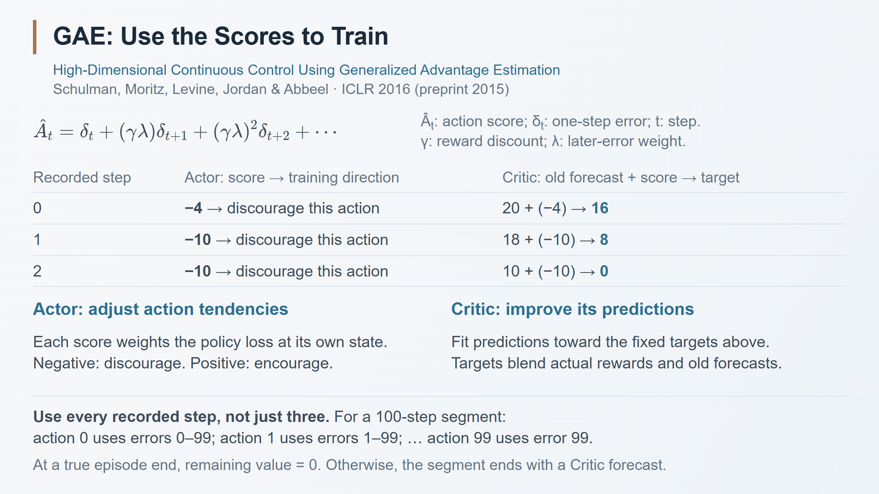
Notes:
Speaker notes
GAE computes a score for every recorded action. It is not a complete optimizer and does not itself update a network. The score is the estimated advantage, not environment reward. The Actor's chosen policy-update rule uses these signed advantages as weights. Negative scores push against the recorded actions at their respective states; shared parameters and the whole minibatch determine the actual update, so do not promise that all three action densities must decrease after a joint update.
For the Critic, this lecture uses the common lambda-return target: G_hat_t=V_old(s_t)+A_hat_t. Here that gives [16,8,0] from old values [20,18,10] and advantages [-4,-10,-10]. Train current Critic predictions toward these fixed targets by squared-error regression. Actual undiscounted remaining returns are [12,6,0]; the targets differ because lambda=.8 blends observations and old forecasts. They are not new measured rewards. Keep old values, advantages and targets fixed during optimization of this collected batch; do not refit the Critic and then recalculate zero errors before training the Actor.
The displayed sum uses residuals through the end of the collected segment, with weight (gamma*lambda)^l for an error l steps later. A 100-step segment means indices 0 through 99. If a true terminal state occurs earlier, stop there; never include the next episode's errors. At a nonterminal collection cutoff, the last TD error includes a bootstrap from the final observation's old Critic value. A time-limit truncation need not be a true terminal state. Data may be processed backwards for efficiency, but all action scores are obtained, not only the first action's score.
Sources: GAE Section 3, Eqs. (10), (16)–(18), https://arxiv.org/pdf/1506.02438 ; common actor-critic training with a GAE-based value target as in https://spinningup.openai.com/en/latest/algorithms/ppo.html . A2C can also use GAE; this is not a claim of universal superiority over A2C.

Slide 12
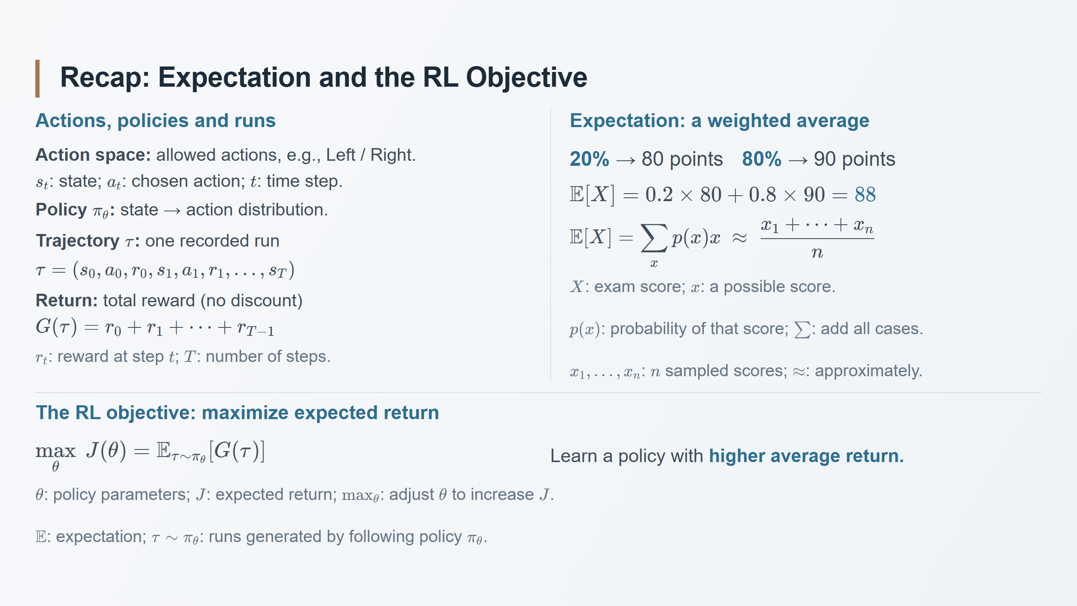
Notes:
Speaker notes
Review the interaction: observe state s_t, sample a_t from the policy's action distribution, receive reward r_t and the next state. The action space is the set of allowed actions; the policy specifies how actions are selected within it. CartPole has Left/Right; the humanoid has a continuous vector of motor controls. A trajectory records the interaction, including rewards. This page uses a complete finite episode with T actions and no discount (gamma=1), so G(tau) is its total reward from the start. At a later step, return means the remaining reward sum; with discounting, future rewards receive powers of gamma.
The exam example is a hypothetical two-outcome distribution supplied in the reference: 20% at 80 and 80% at 90. Its expectation is 88, although an individual result is either 80 or 90. The sample average estimates the expectation when scores are sampled from that same distribution; a finite average need not equal 88. Capital X denotes the random score, lowercase x a possible value, and x_i the observed score on trial i. E is the probability-weighted average, sum adds over possible discrete outcomes, and approximately marks the sampling estimate. For a continuous variable, the corresponding definition uses an integral.
For RL, replace the exam result by the return of an entire run. J(theta) averages returns over trajectories generated by the policy together with the environment and starting-state distribution. It does not weight all conceivable trajectories or states equally, and it does not guarantee the best result in every individual run. Hold the evaluation setting fixed when comparing policies. Adjusting theta changes the action distribution and therefore the distribution of trajectories and their returns. The objective shown is the finite-episode, undiscounted teaching case, not a per-step loss or a GAE advantage score. The max indicates the optimization objective, not a guarantee that training finds the global optimum.

Slide 13
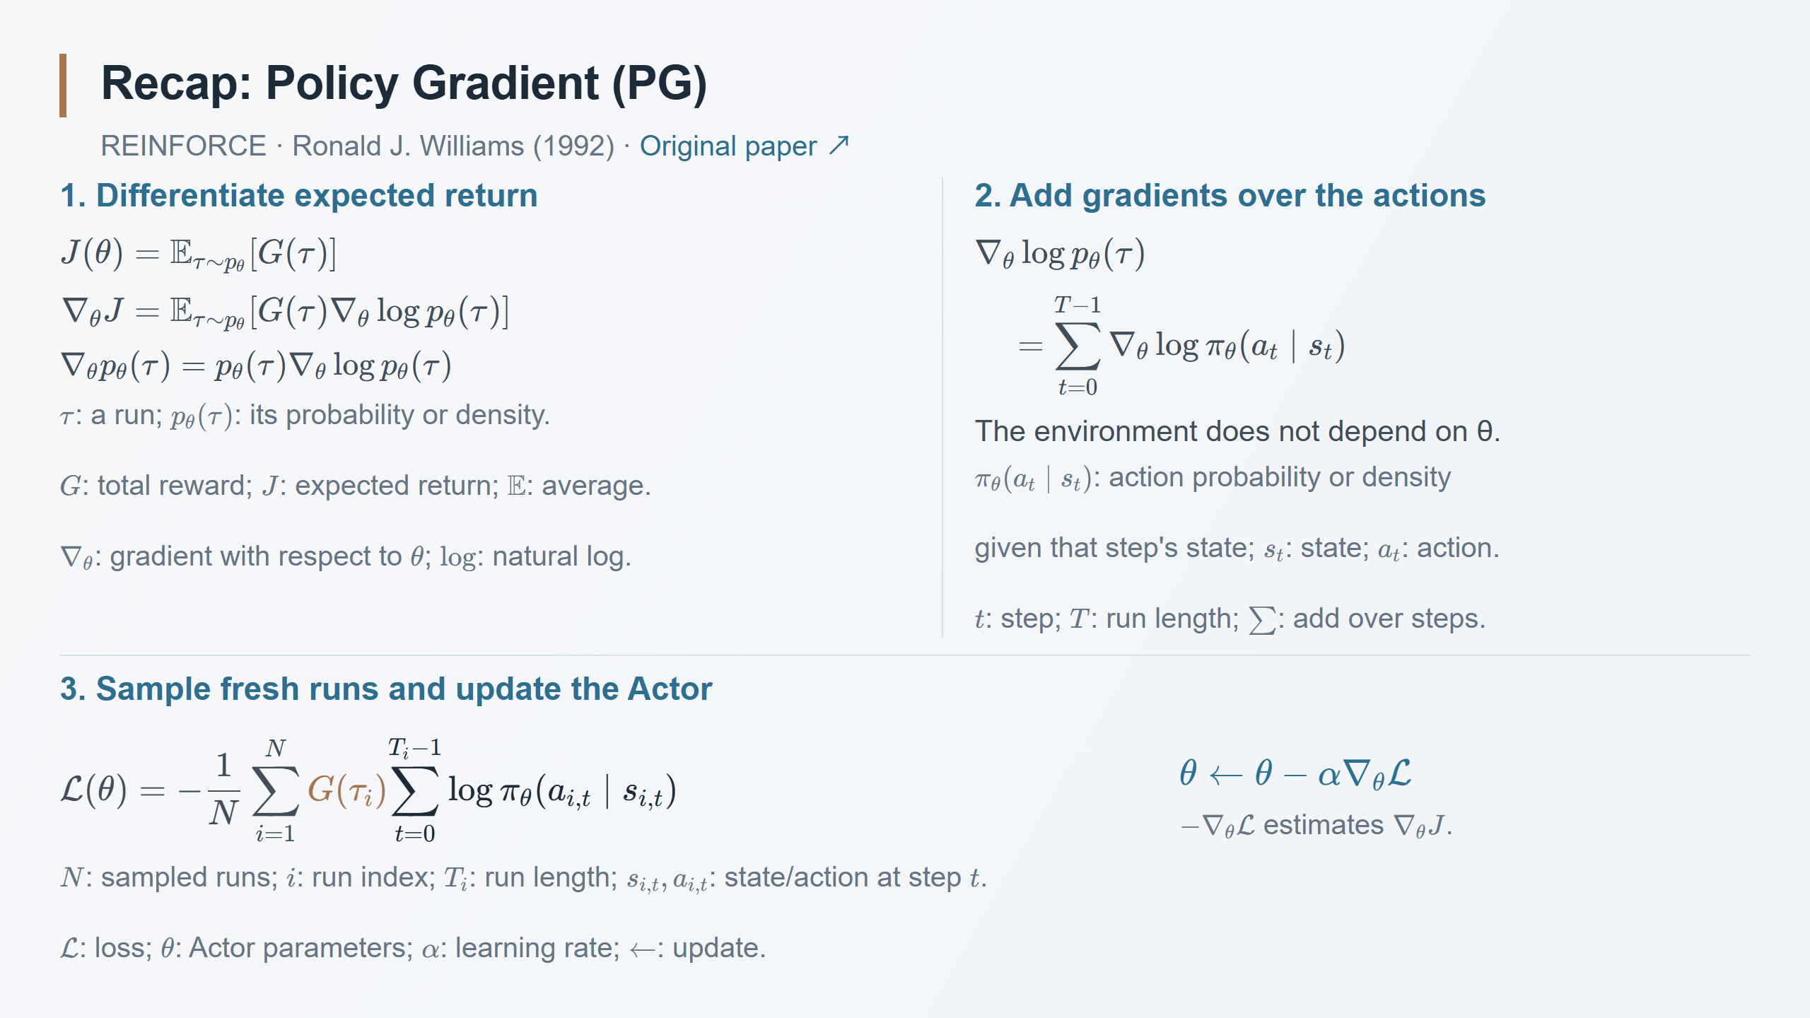
Notes:
Speaker notes
Continue the finite-episode, undiscounted setting from the previous recap. Trajectory likelihood includes the initial-state distribution, policy action likelihoods and environment transitions (including any reward randomness). Only the policy depends on theta, so environment terms disappear after taking the log gradient, not from the trajectory probability itself. The score-function identity gives the expected-return gradient under standard regularity assumptions. Continuous trajectories use densities and integrals.
The sampled loss uses whole-run return G(tau_i), as in the supplied derivation. Earlier slides used reward-to-go: past rewards can be omitted without changing the expected policy gradient. Do not claim these two finite-sample estimates are numerically identical. Evaluate the loss gradient at the policy that collected the fresh runs, treating all sampled data and returns as constants. The negative sign turns gradient descent on the loss into an estimated ascent step on expected return. This loss is not the expected return itself, and a lower sampled loss does not guarantee a better next run. The three earlier CartPole runs would supply whole-run weights 40, 180 and 100, each applied to that run's own recorded state-action pairs.
Original reference: Ronald J. Williams (1992), Simple Statistical Gradient-Following Algorithms for Connectionist Reinforcement Learning, https://doi.org/10.1007/BF00992696 . Modern episodic derivation: https://spinningup.openai.com/en/latest/spinningup/rl_intro3.html . Policy-gradient update overview: https://spinningup.openai.com/en/latest/algorithms/vpg.html .

Slide 14
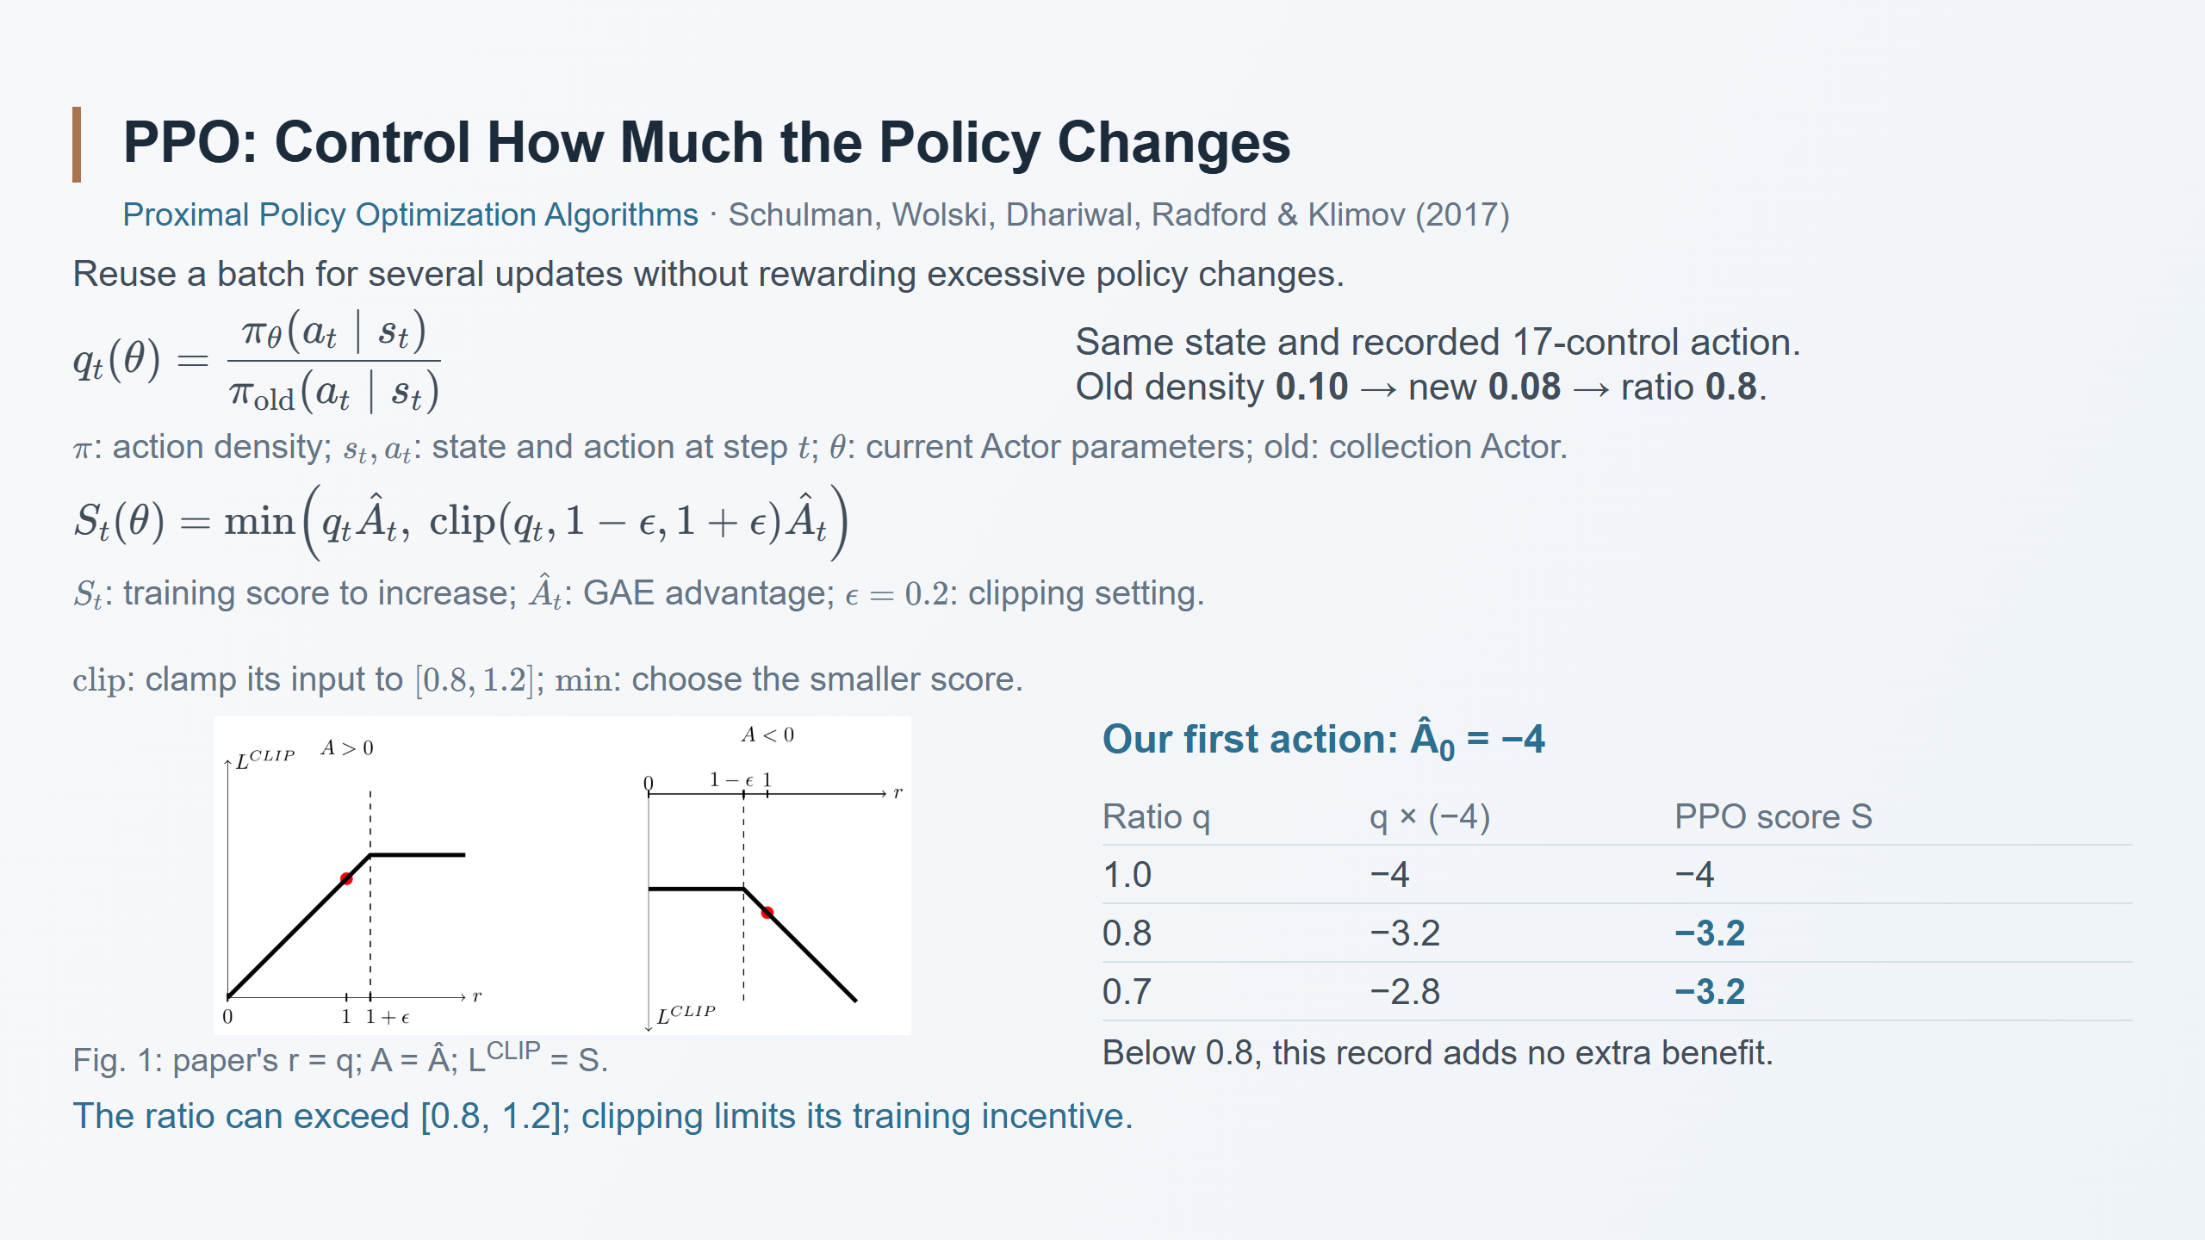
Notes:
Speaker notes
Use the stored humanoid action at step 0, whose GAE advantage was -4. The 0.10 and 0.08 joint densities are illustrative. They refer to the entire 17-control vector, not to motor-command magnitudes. The denominator stays fixed. At q=.7, min(-2.8,-3.2)=-3.2. For a positive advantage, the beneficial plateau instead starts at 1.2. Changes in the harmful direction remain penalized. S is a surrogate training score, not measured reward or expected return. The figure's horizontal r is our q; its vertical L^CLIP is the single-record score S. We focus on PPO-Clip.
Source: Schulman, Wolski, Dhariwal, Radford and Klimov (2017), Proximal Policy Optimization Algorithms, Eq. (7), Figure 1, https://arxiv.org/pdf/1707.06347 . Intuition and clipping caveat: https://spinningup.openai.com/en/latest/algorithms/ppo.html .

Slide 15
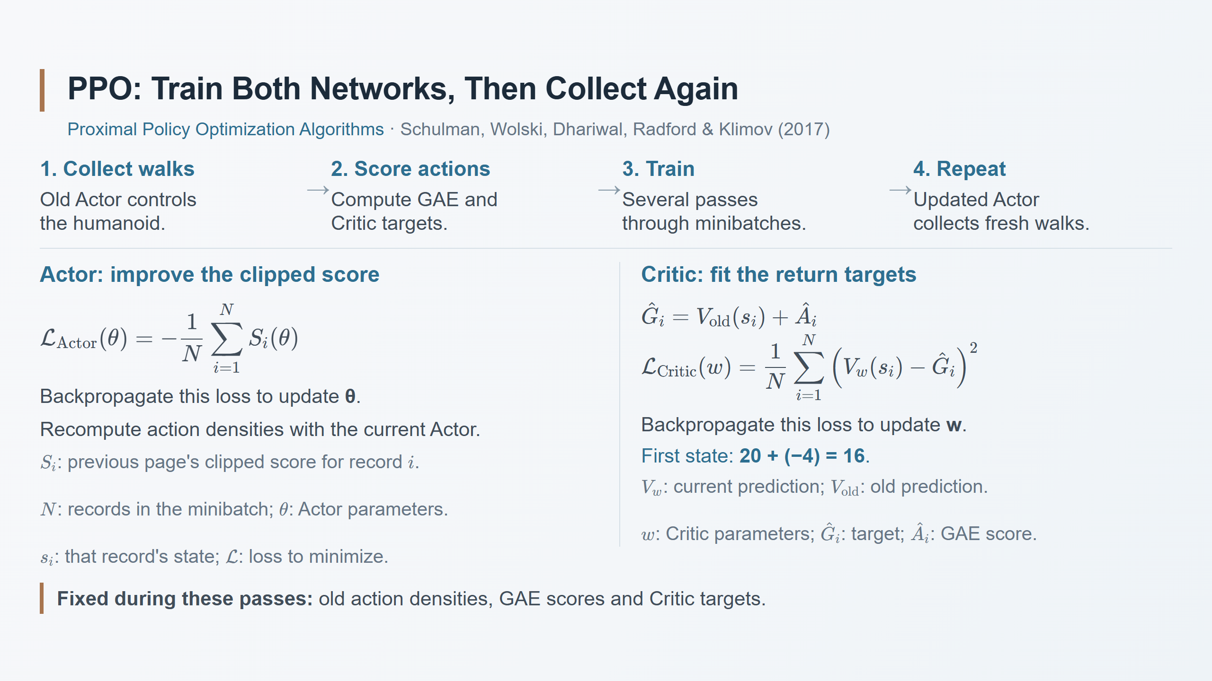
Notes:
Speaker notes
Sampled steps are pooled into minibatches; N here counts minibatch records, unlike the paper's parallel-actor count. Use the GAE-based target from the earlier lesson: old value 20 plus advantage -4 gives 16. This is a blended target, not the observed remaining return 12. Stop gradients through old densities, advantages and targets. The current Actor and Critic change across a limited number of passes; then collect fresh data. The two displayed losses omit optional entropy bonuses and implementation-specific value clipping. Shared networks may combine weighted losses.
Sources: PPO Section 5, Algorithm 1 and Eq. (9), https://arxiv.org/pdf/1707.06347 ; https://spinningup.openai.com/en/latest/algorithms/ppo.html . GAE-based targets continue the preceding numerical example.

Slide 16
